Slide 1
Introduce Self
> Note what each member is working on
Brief Introduction
> Name
> Goal
> Story
> Who presents the storyboard?
Context Diagram
Diagram 0
Global Use Case
> Involves all members
> Shows what data is passed between sub-systems
Individual Presentation
> Introduce Feature
> Explain role in overall project
> Explain feature priority
> Walk through use case and class diagrams
> Estimate the complexity of the work relative to the other features
> Answer Questions

Slide 2

Tappa Tappa Keyboard
Julia Abdel-Monem
Jason Culbertson
Ferris Hammes-Buehler
Taran Haug
Gavin Haynes

Slide 3
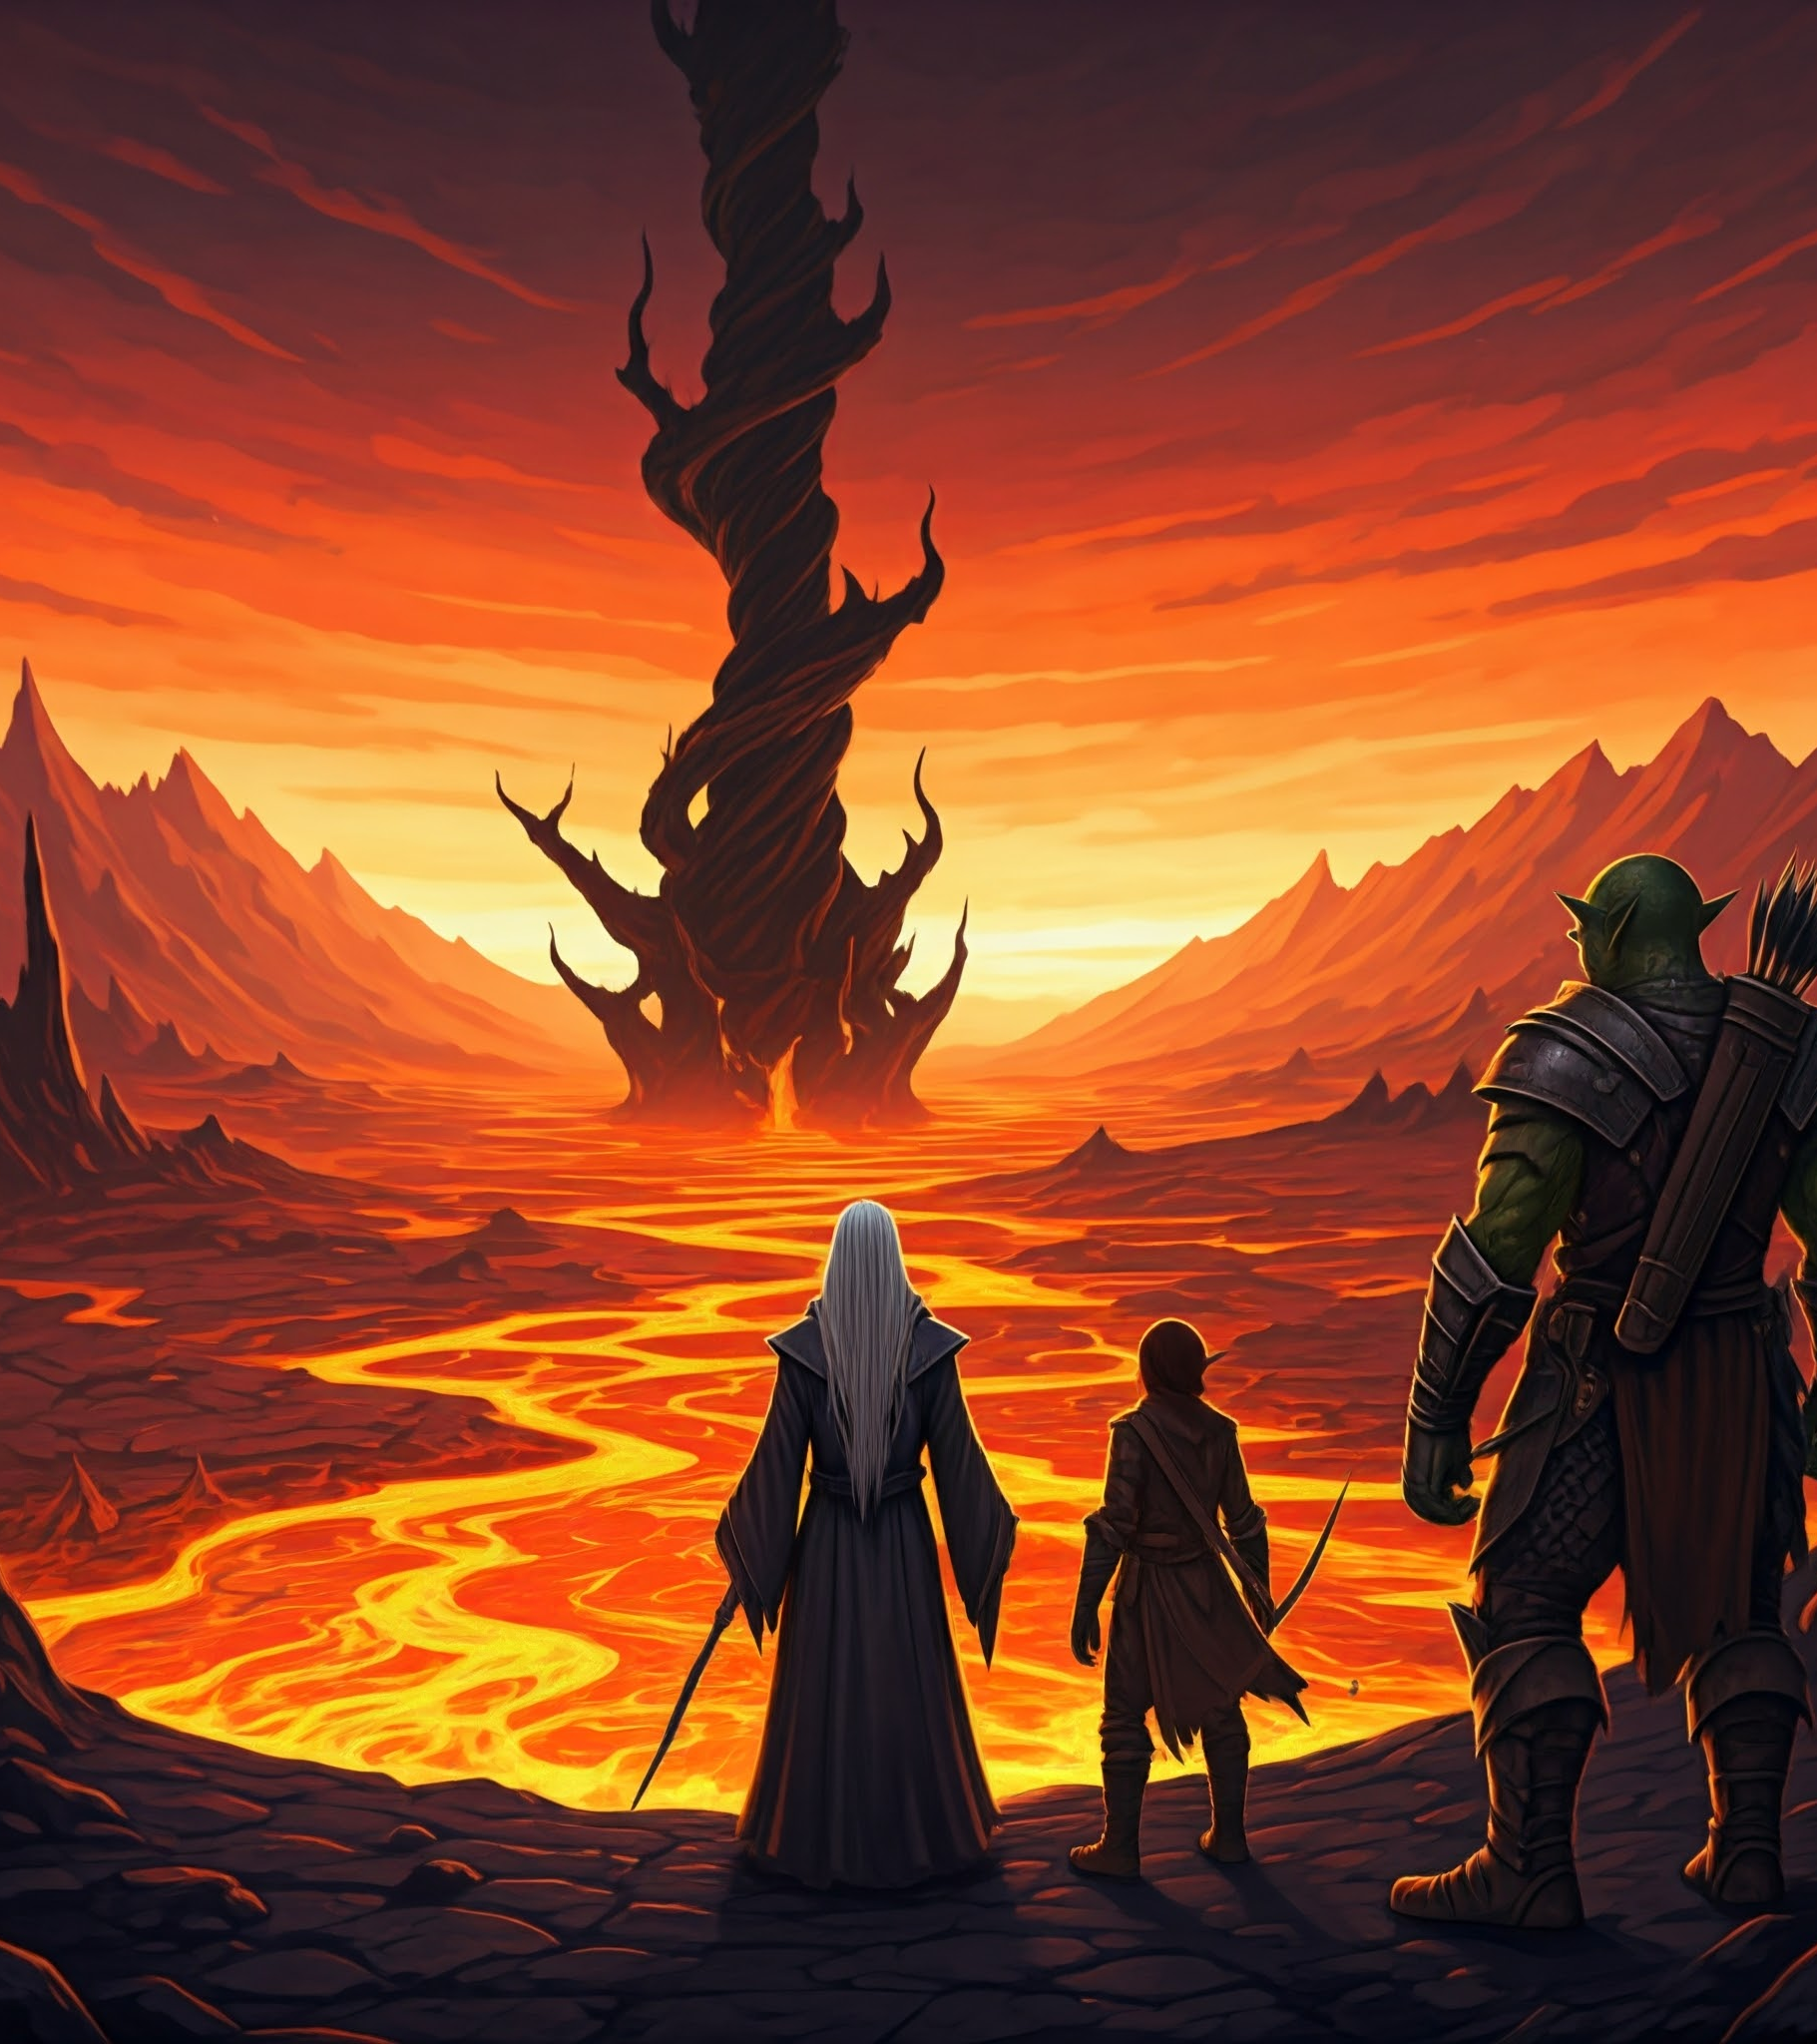
Our heroes, the Wizard, an elderly human male, the Fighter, nan early-age male orc, and the Rogue, a young elf female, approach the evil Necromancer's tower, a twisted black spire surrounded by a moat of lava.

Slide 4
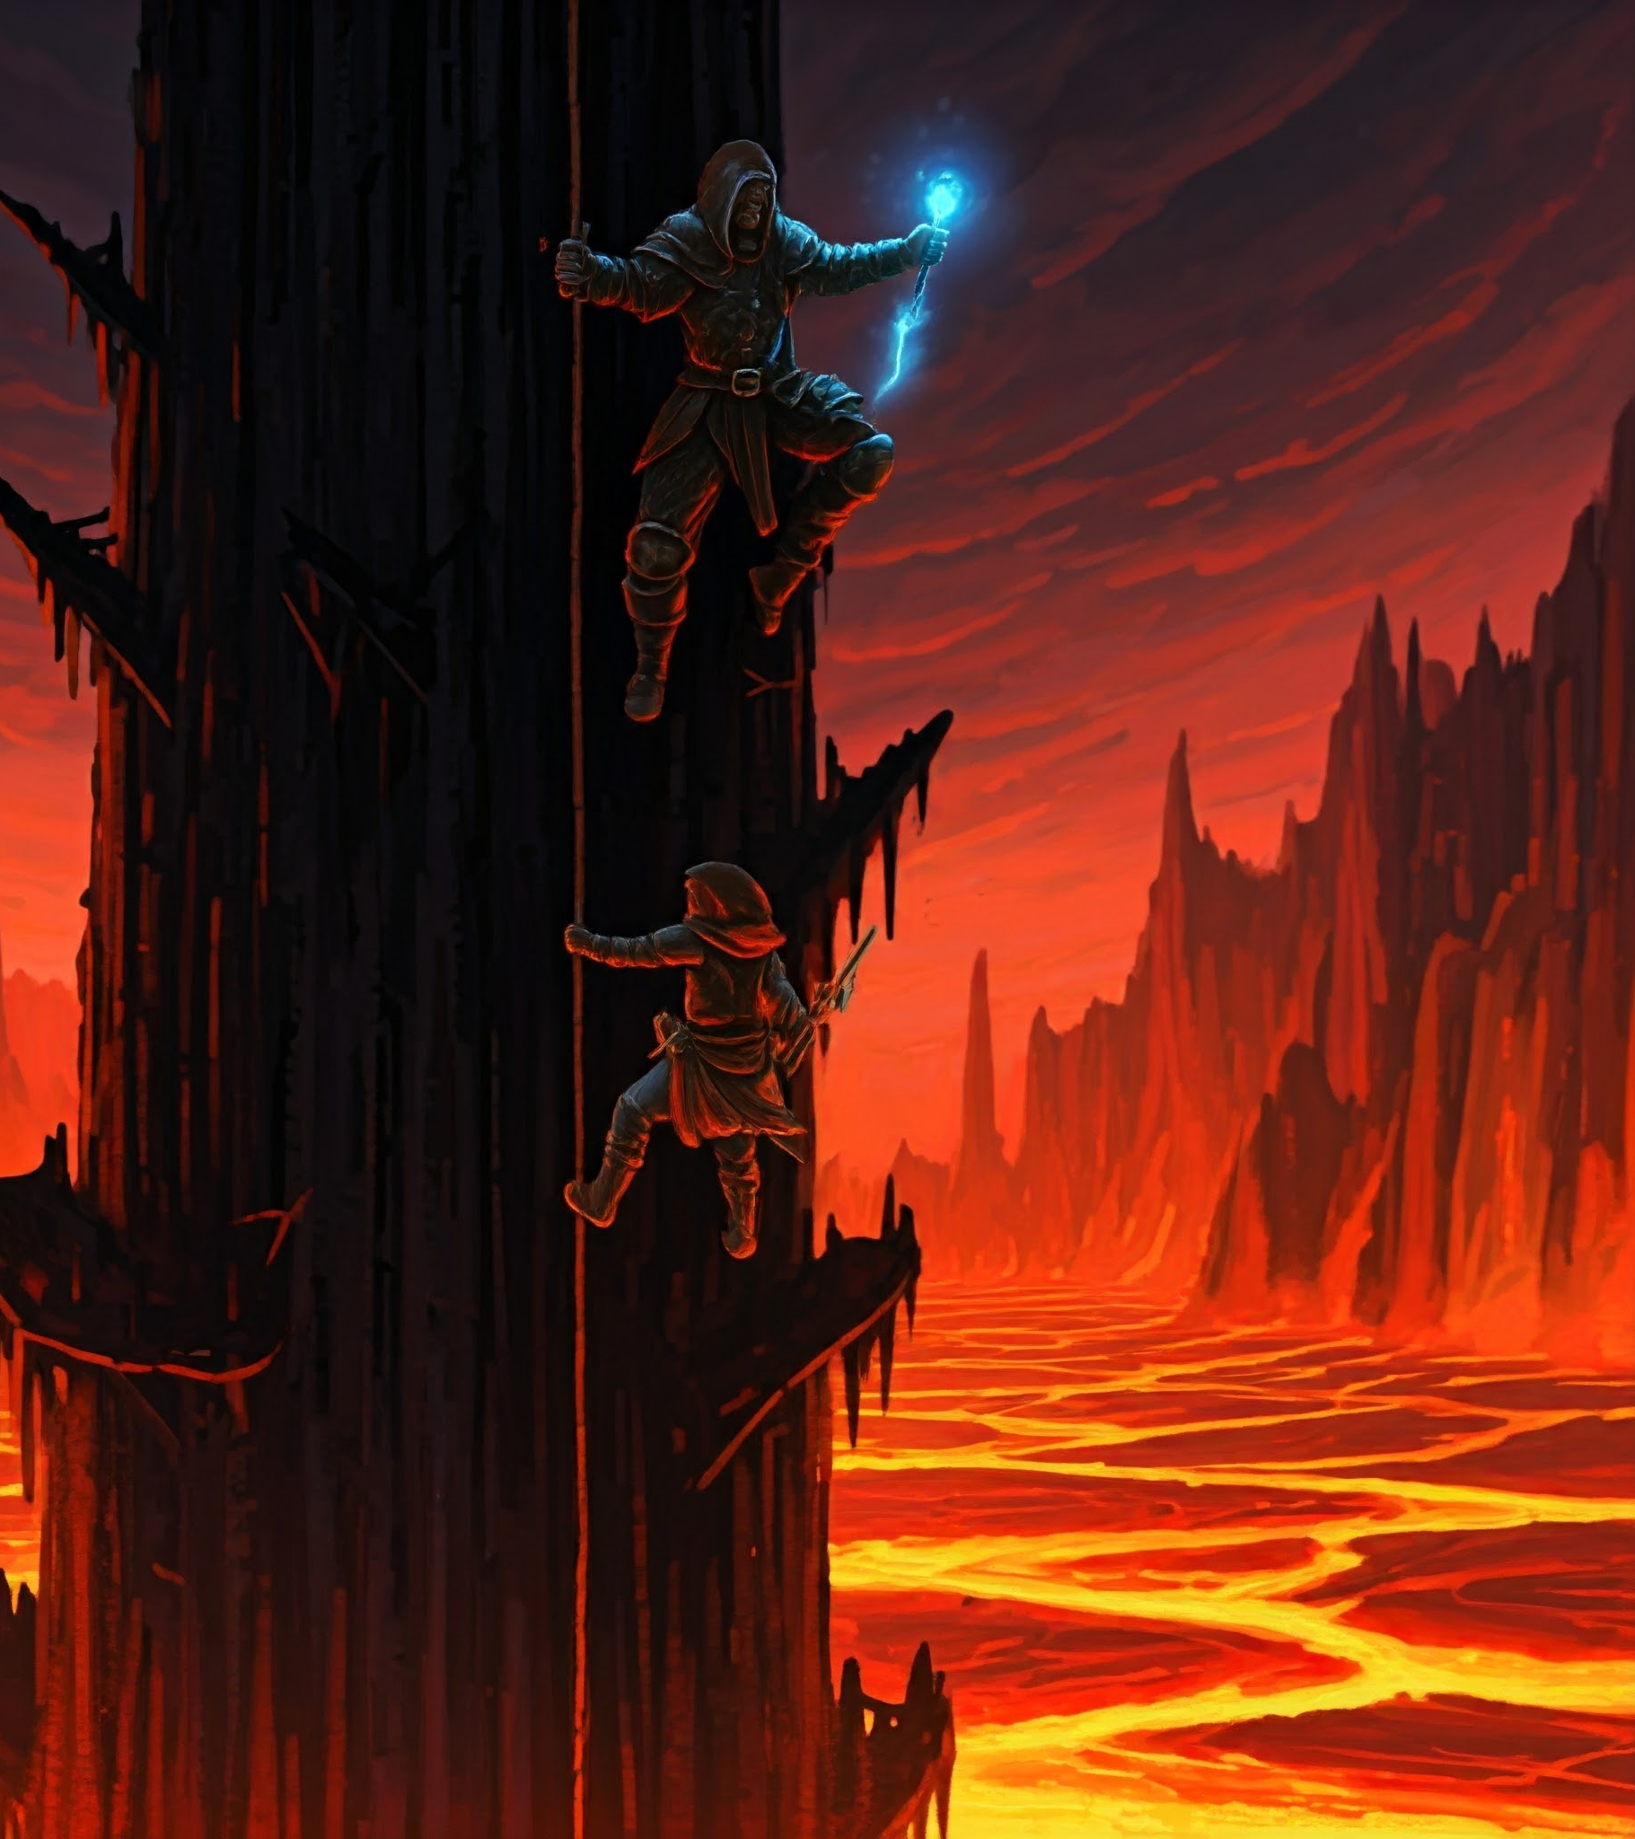
Our heroes enter the tower and begin to ascend, climbing both within and without the tower.

Slide 5
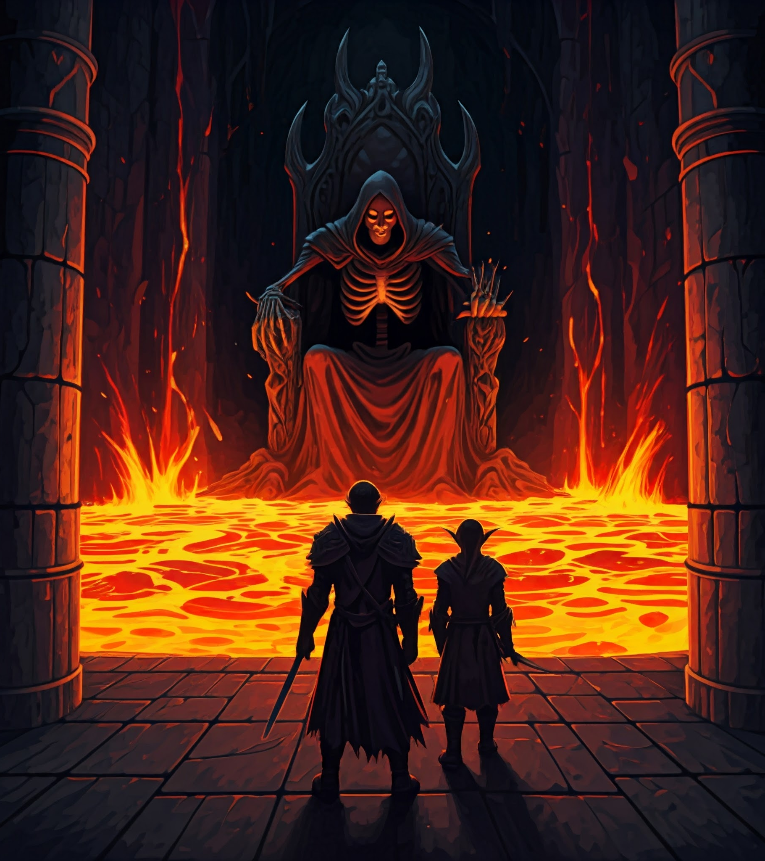
As our heroes approach the necromancer's throne room, he causes lava from his moat to flood the tower, quickly rising to swallow the heroes.
The necromancer swiftly flies to the top of the tower.

Slide 6
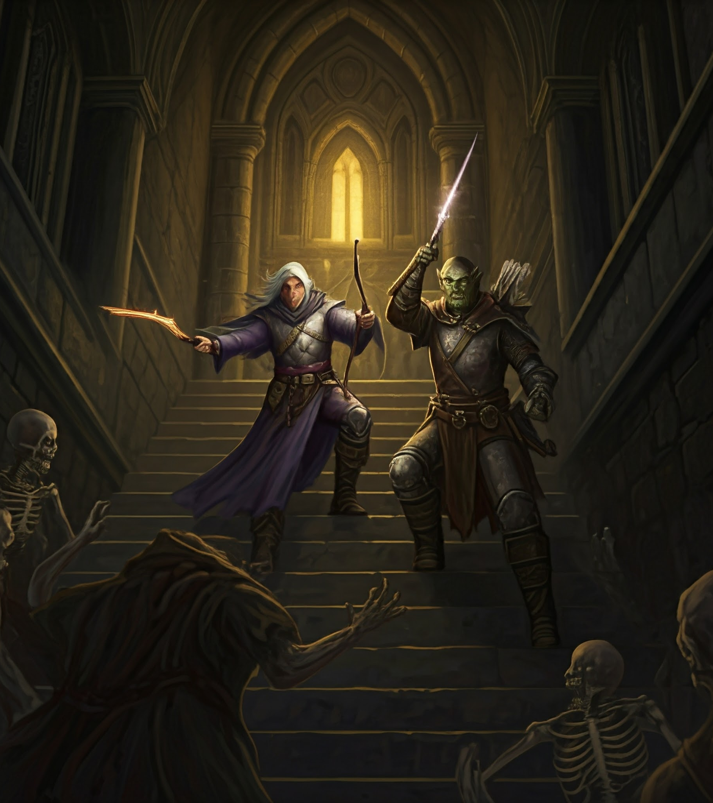
As the heroes ascend after him, they discover that he has summoned hundreds of undead, goblins, and slimes to kill the heroes before they reach him.

Slide 7
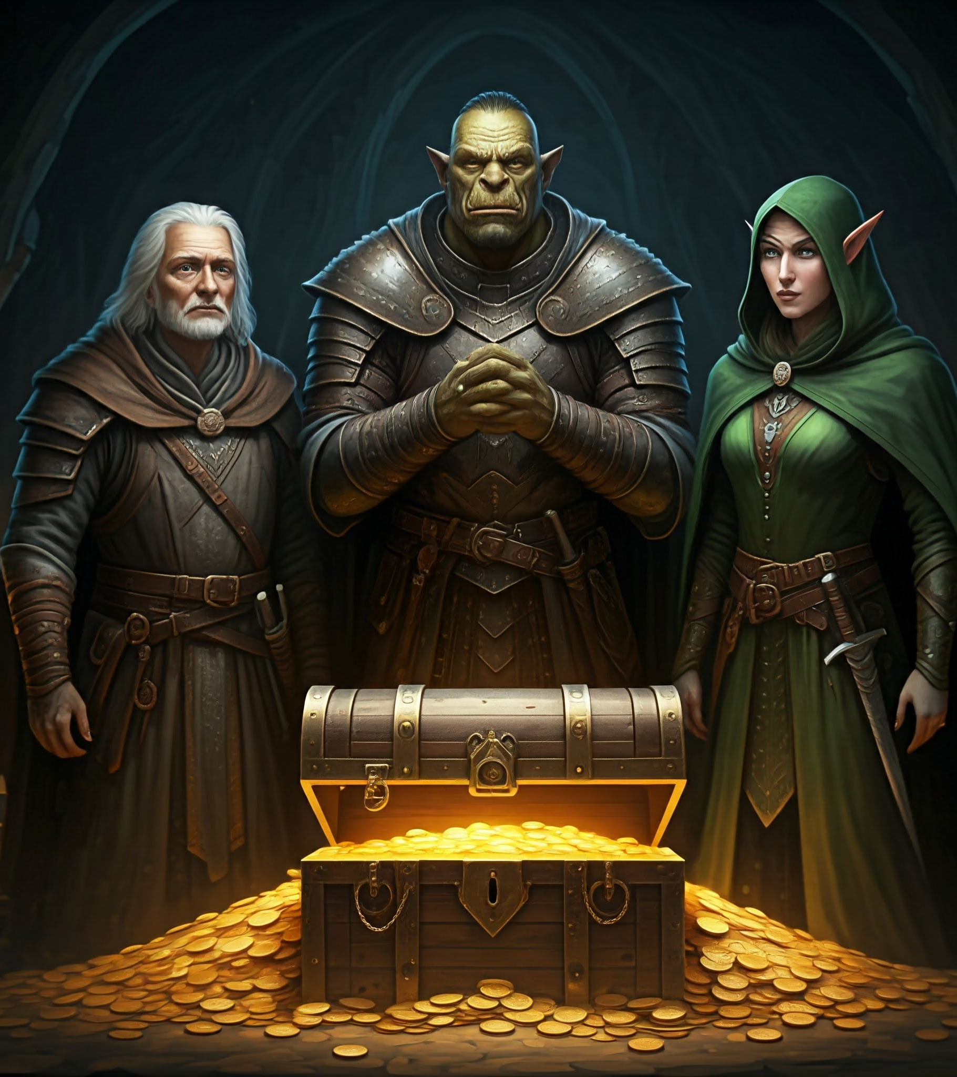
Our heroes slay many enemies, and loot the tower on their way to the precipice.

Slide 8
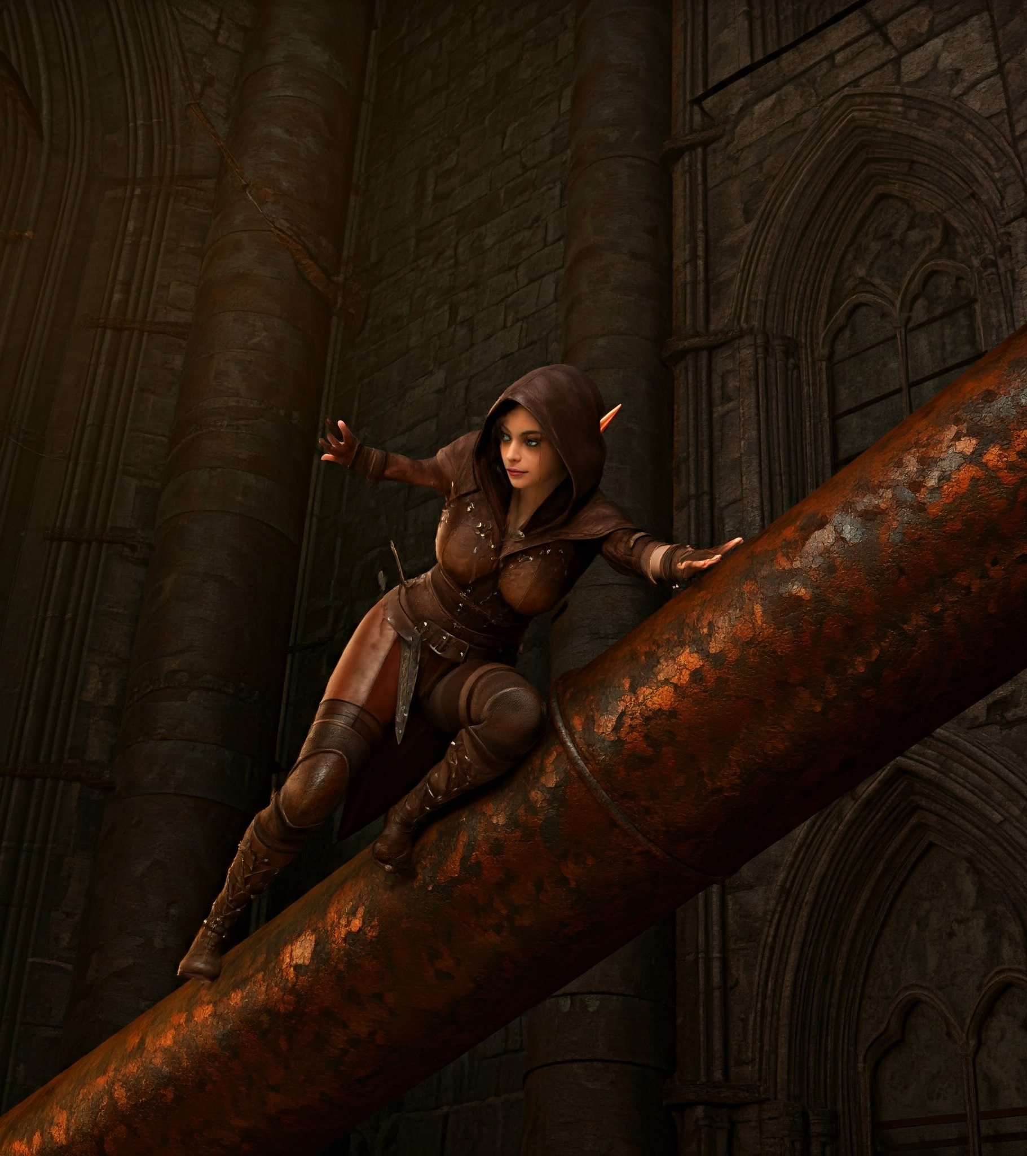
The Rogue's dexterity allows her to climb up exposed metal pipes.

Slide 9
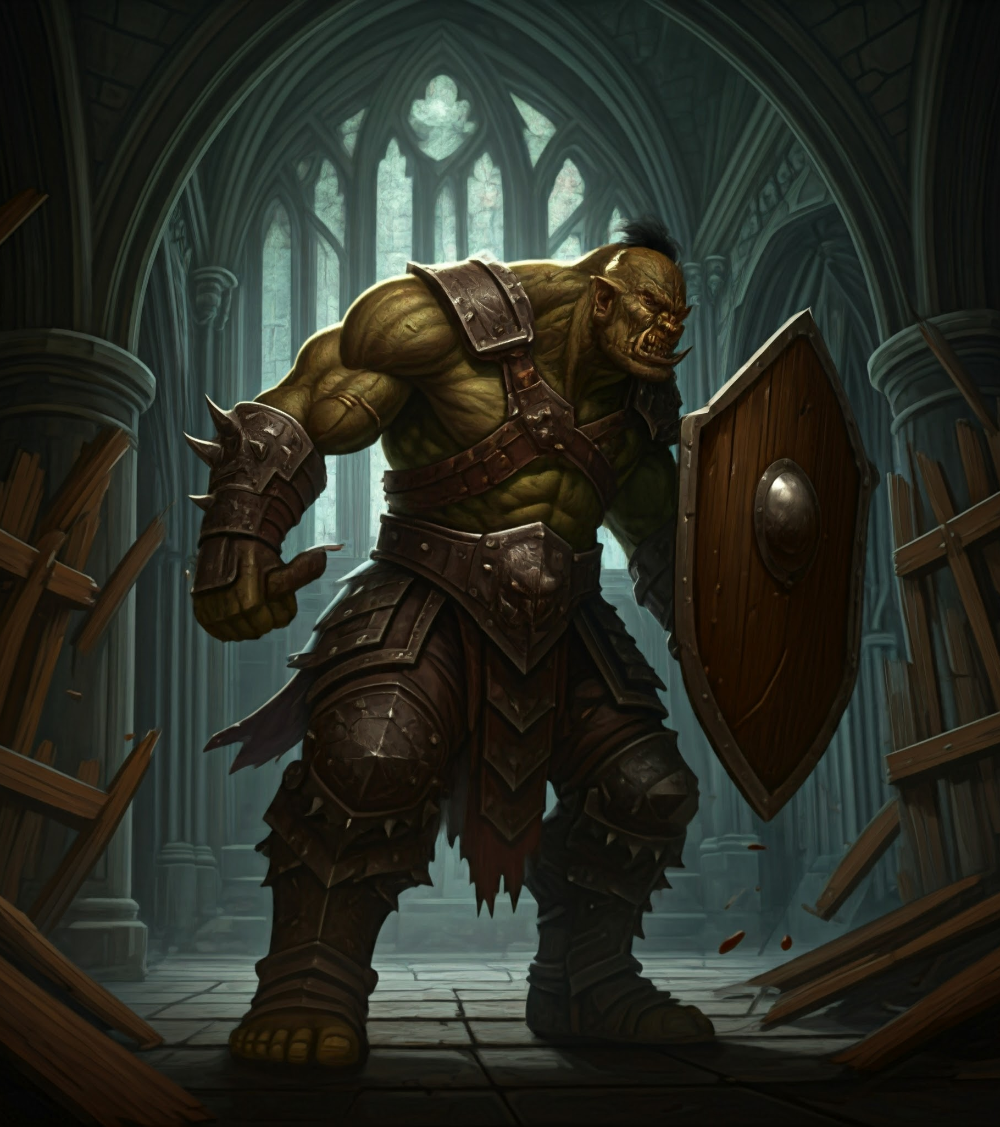
The Fighter's strength allows him to bash down wooden barricades.

Slide 10
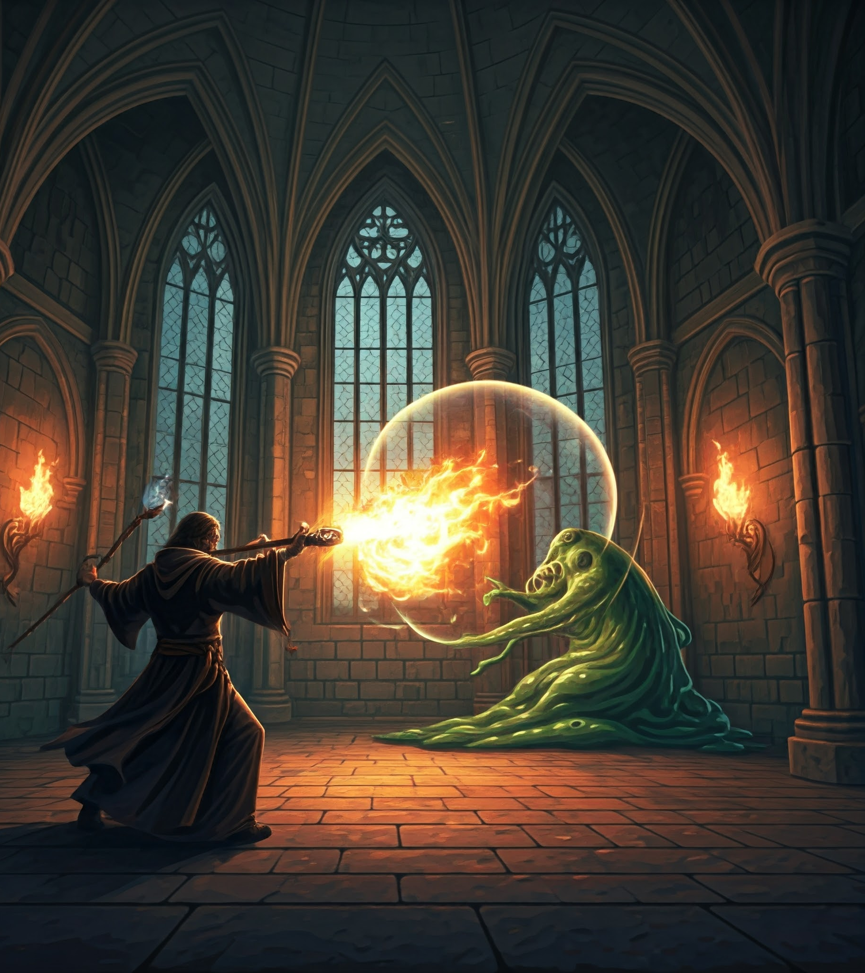
The Wizard's magical prowess allows him to attack at a range.

Slide 11
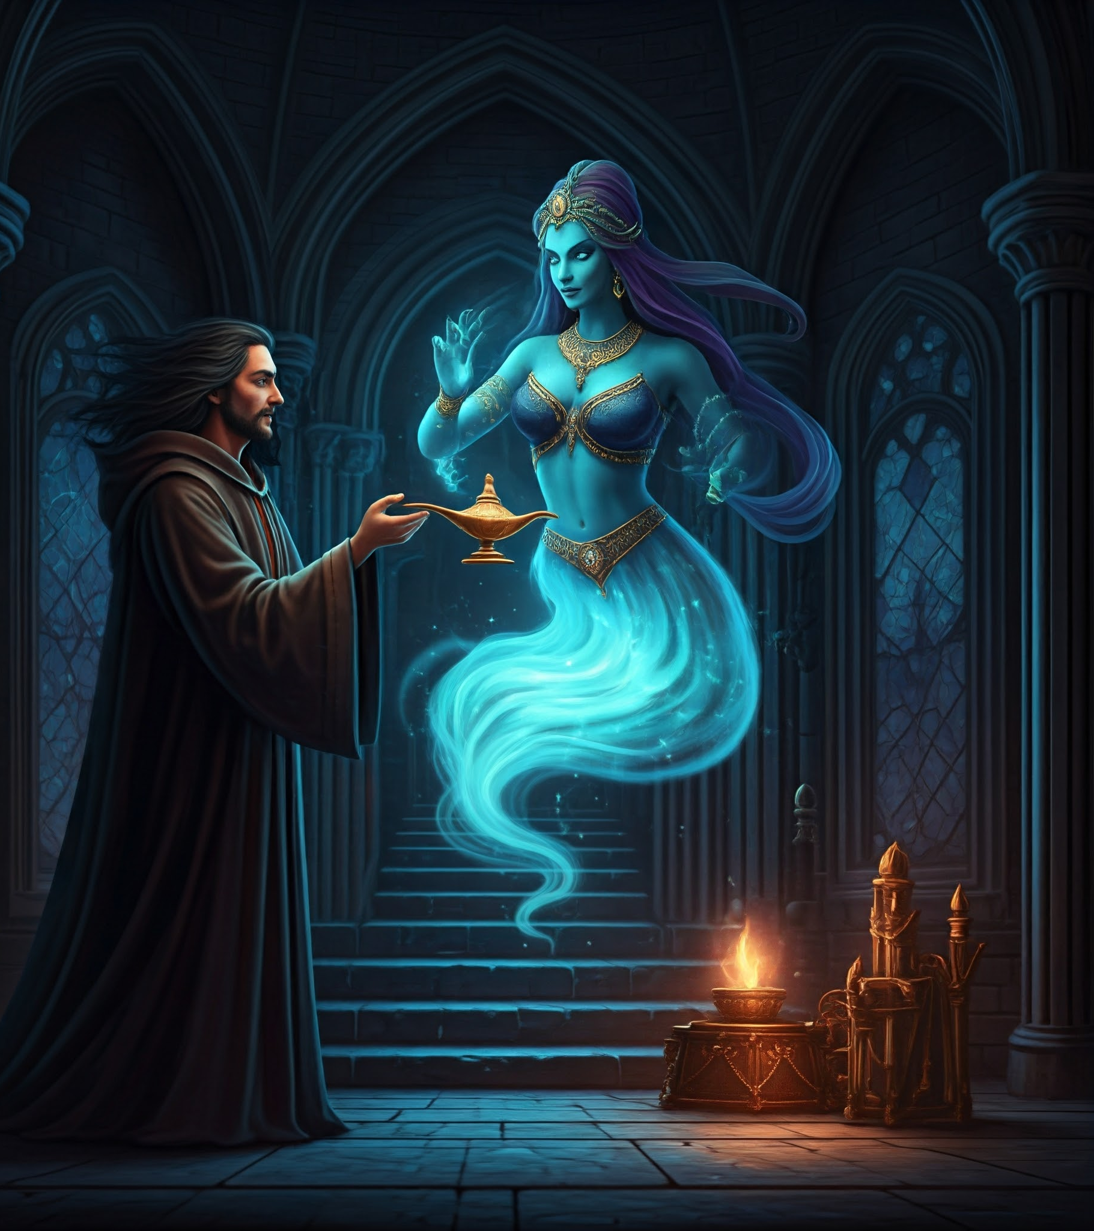
The Wizard finds a brass lamp, summoning a Genie from within.

Slide 12
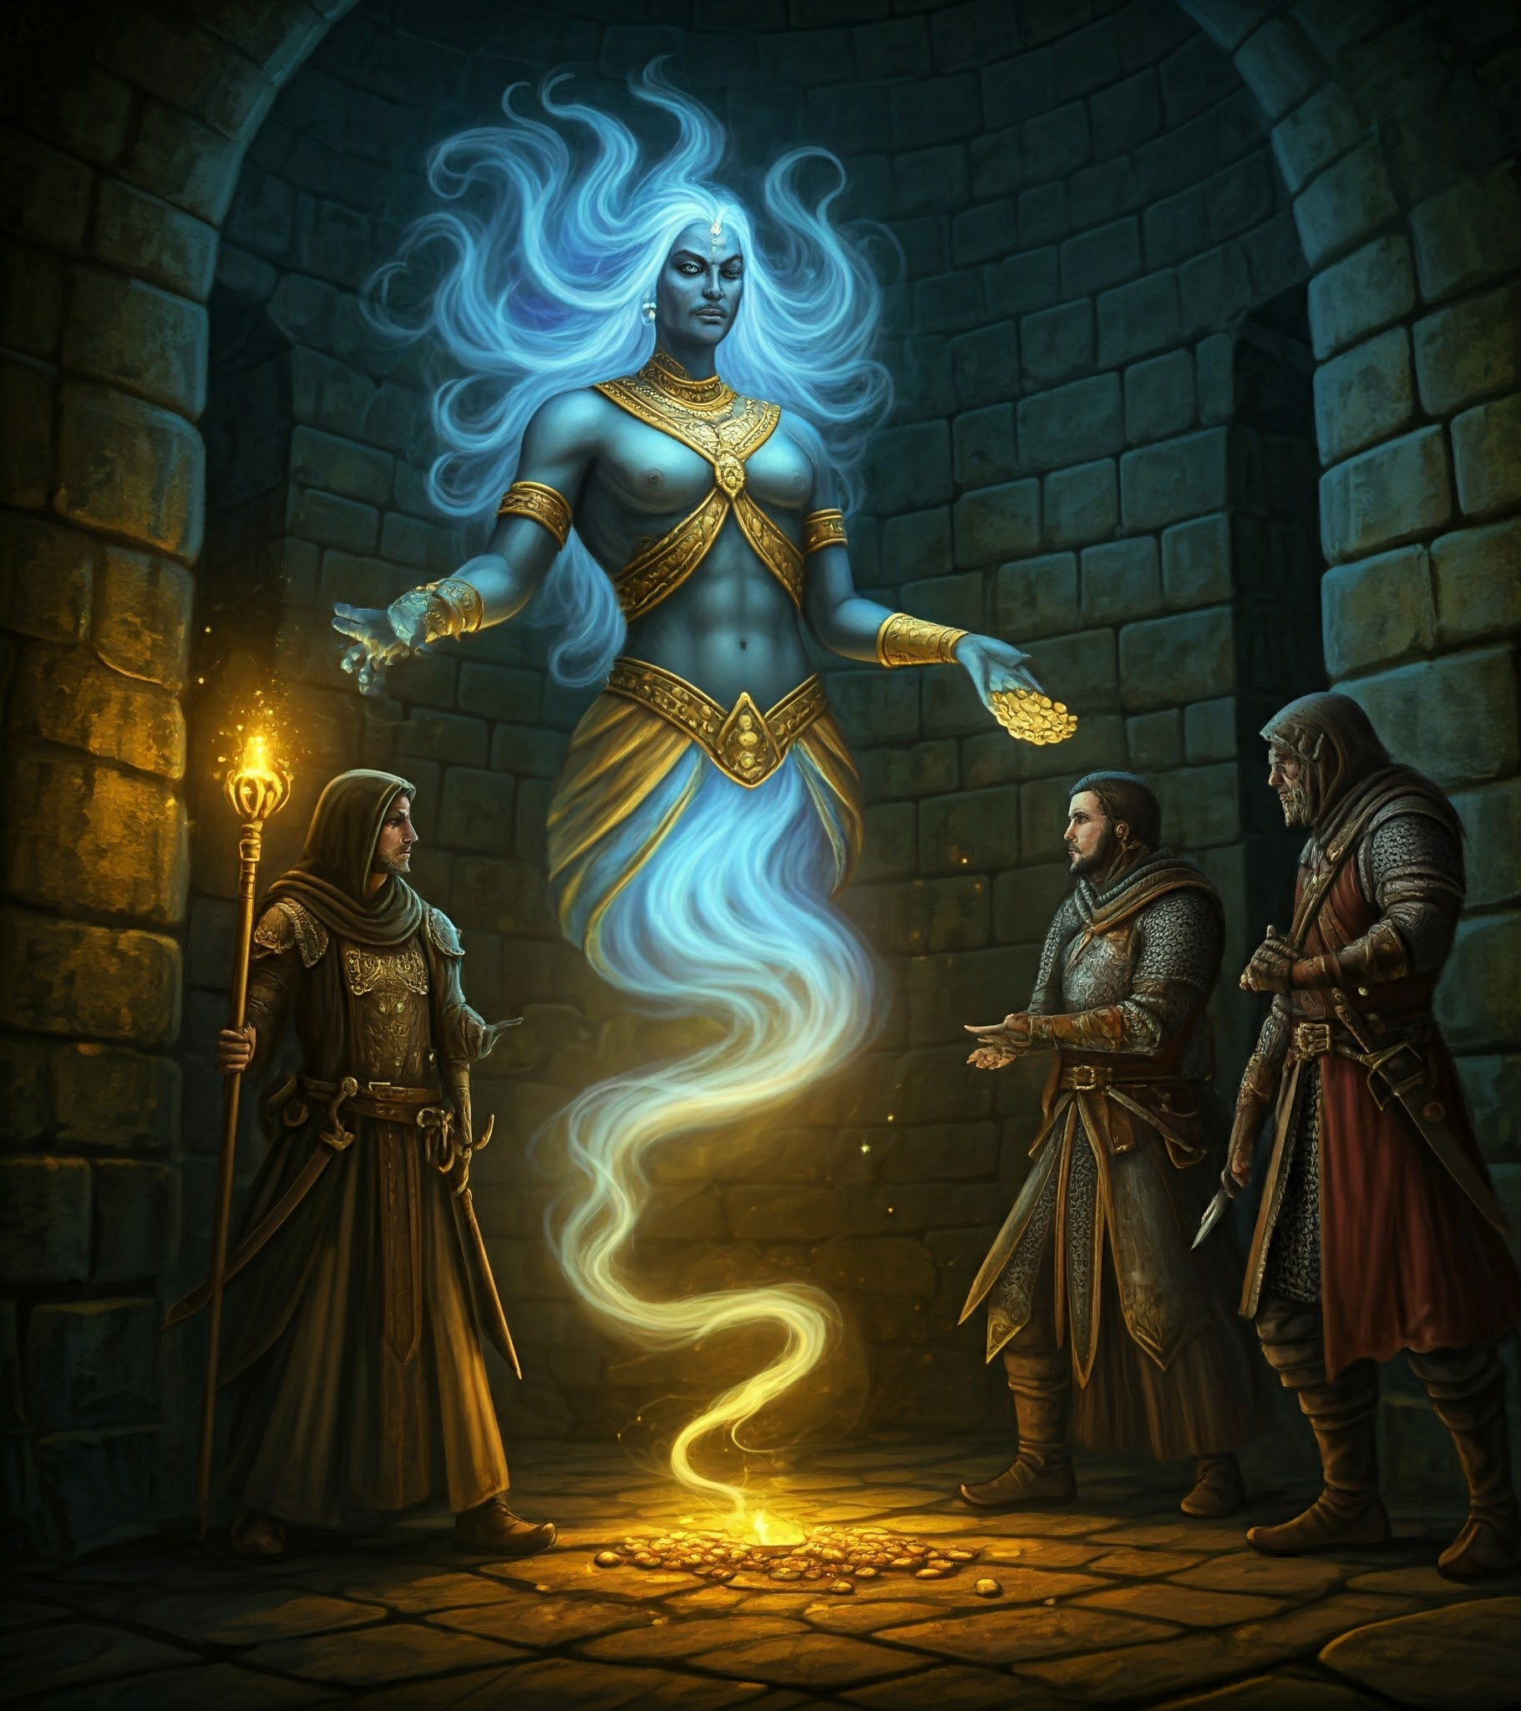
The Genie takes the parties accumulated loot, trading it for magical enhancements.

Slide 13
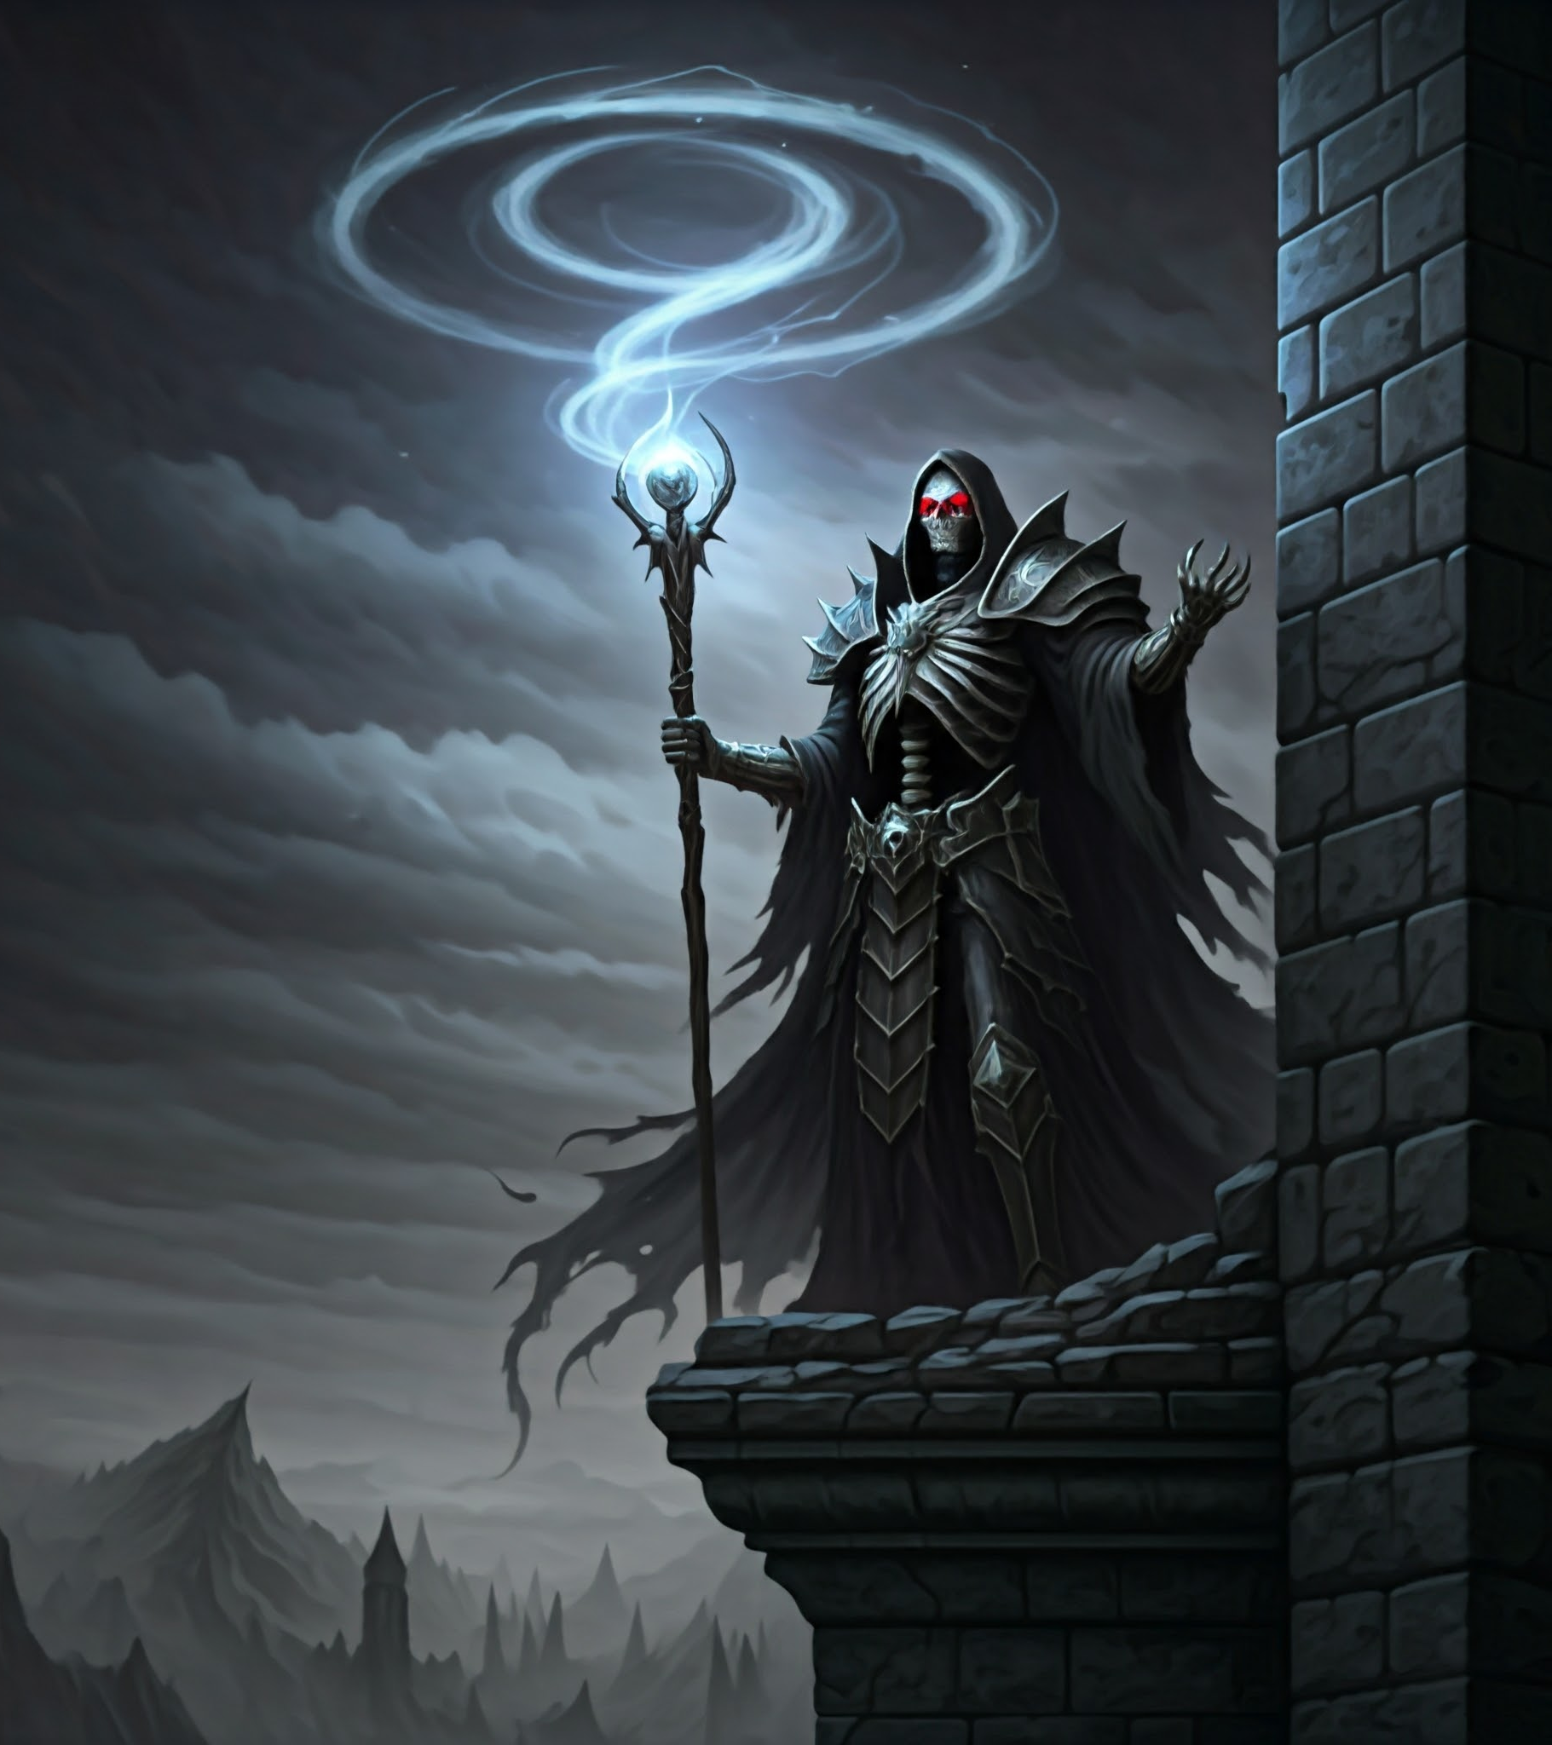
Reaching the tower's heights, they challenge the Necromancer.

Slide 14
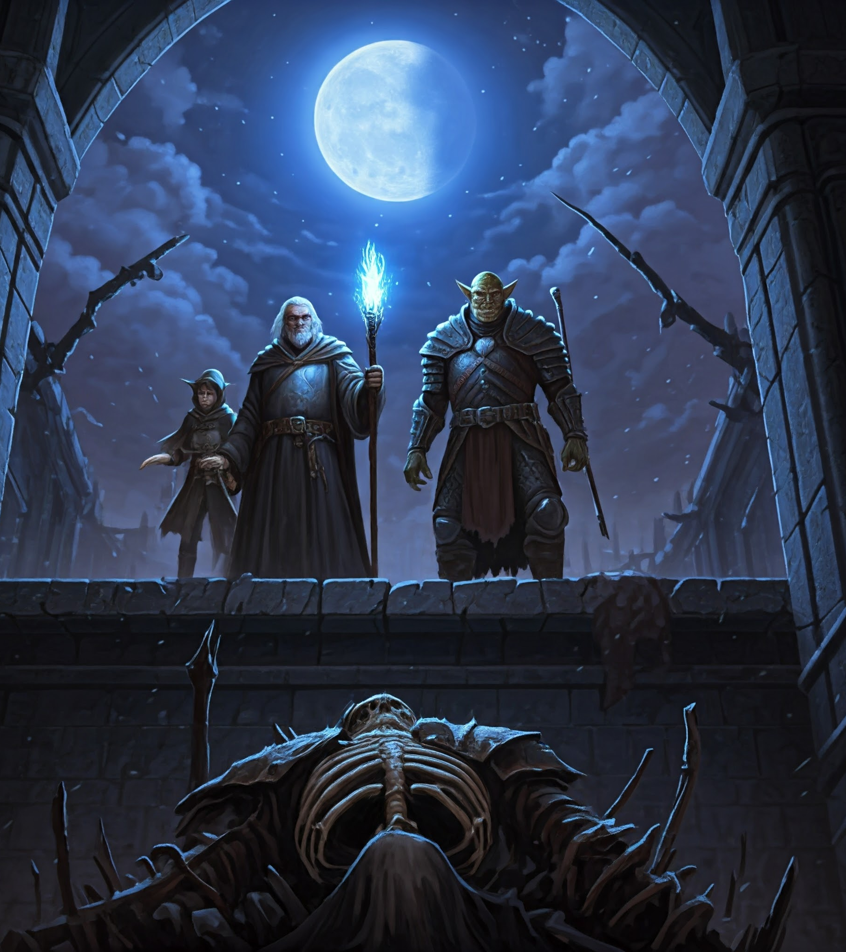
Our heroes slay the Necromancer.

Slide 15
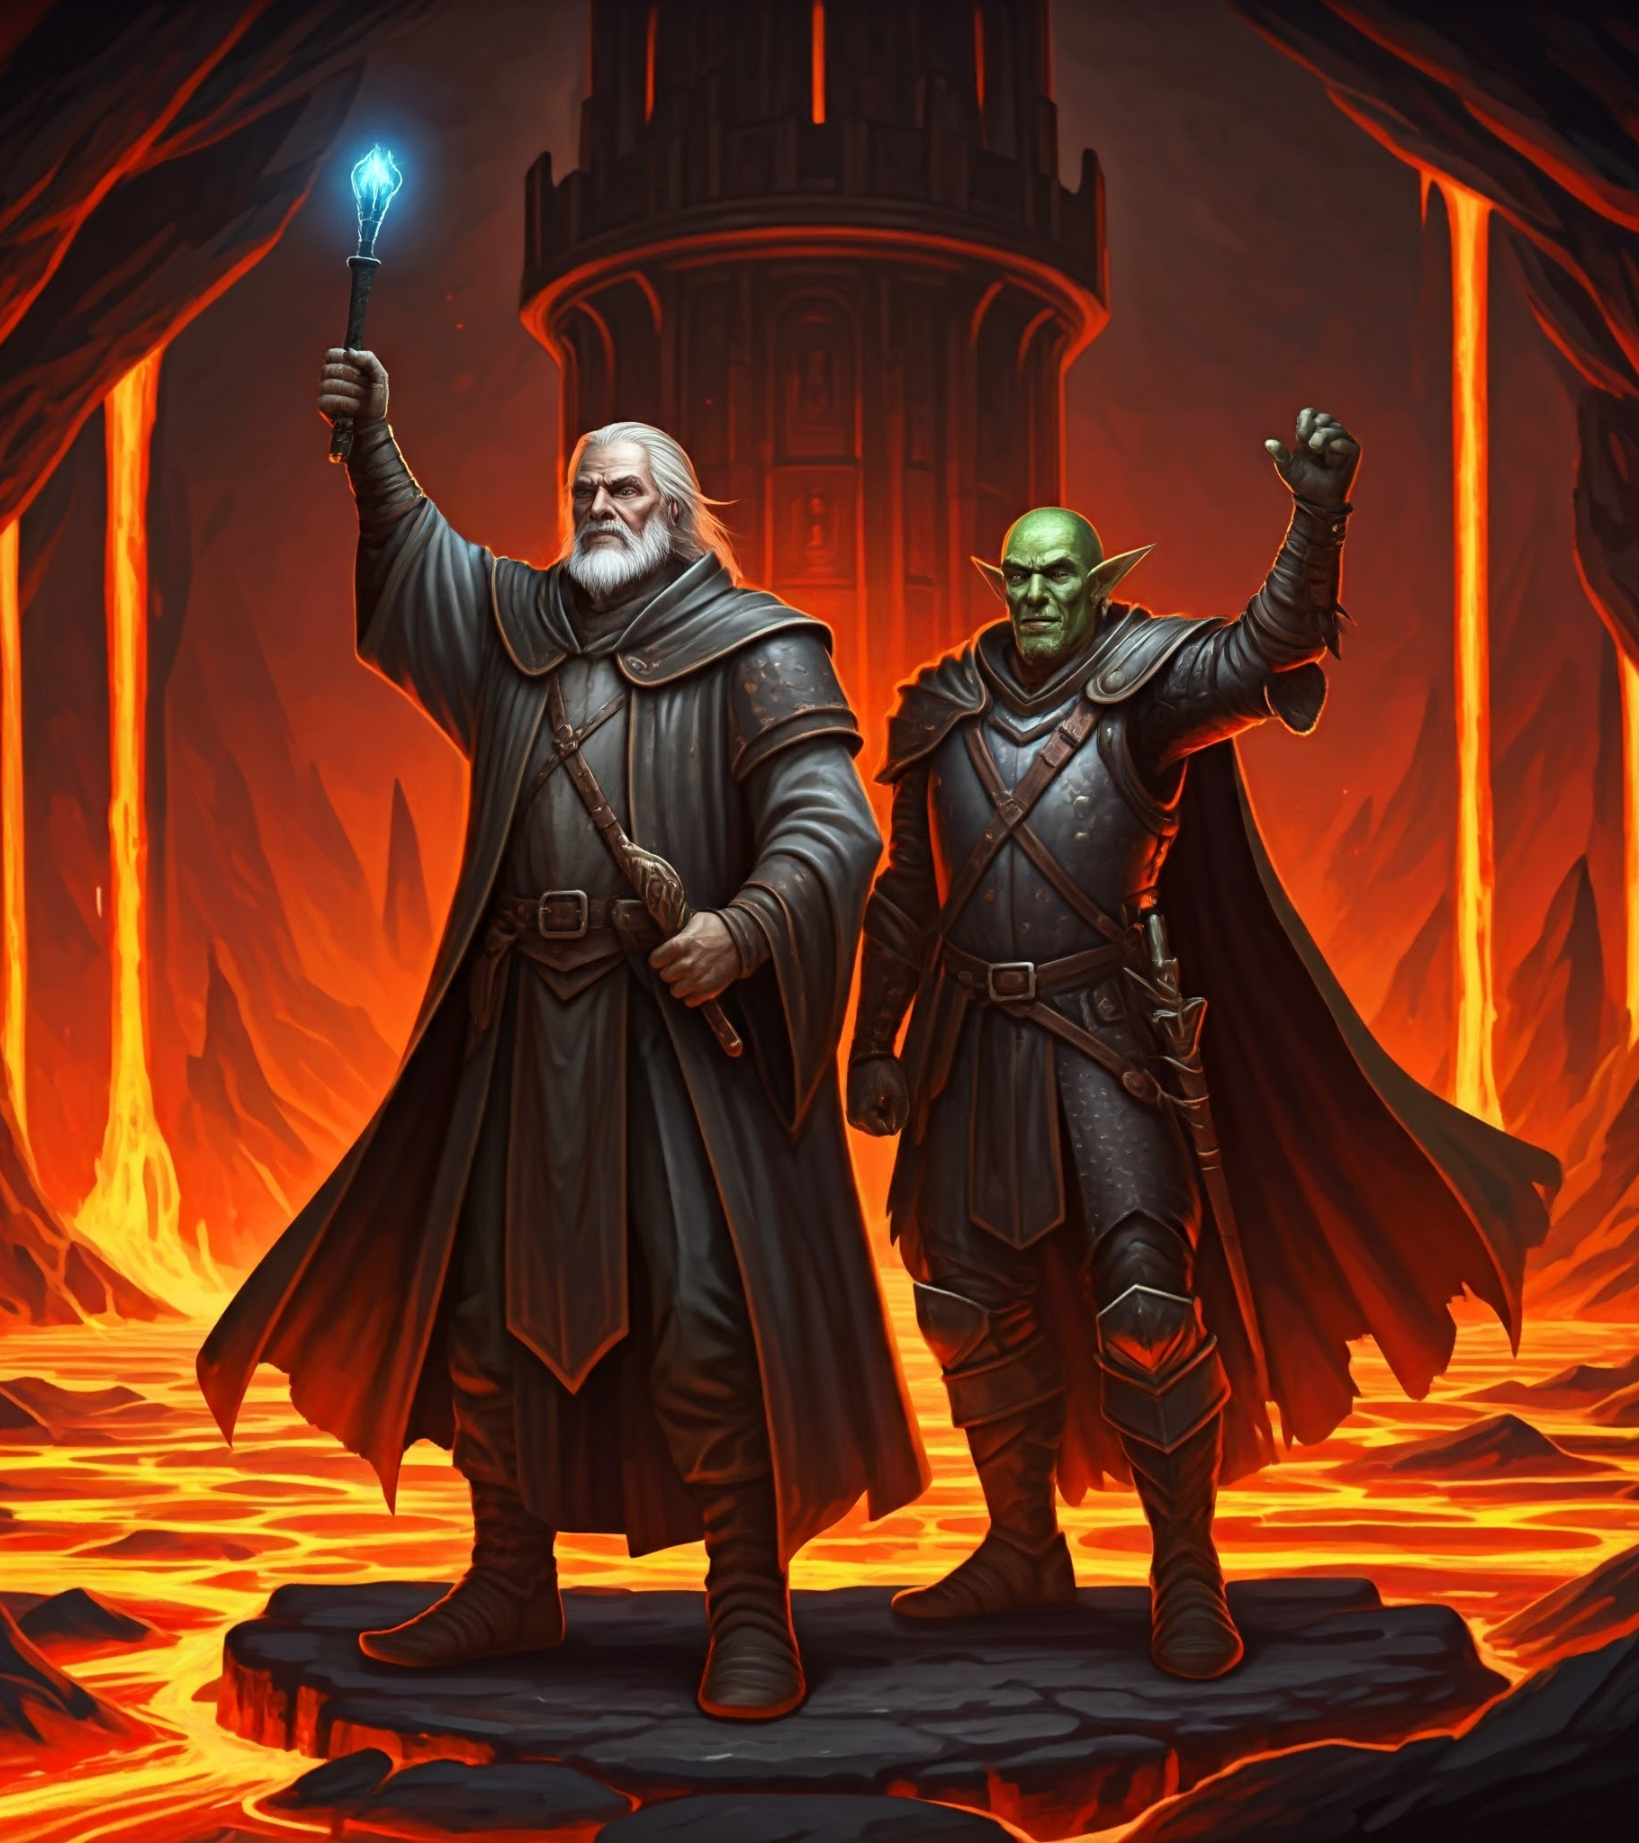
With the necromancer dead, the lava falls away, and our heroes celebrate!

Slide 16
Hero Climb
Hero Classes
The Fighter
The Rogue
The Wizard
The Goal: Ascend the Necromancer's Tower and defeat the Necromancer.
Enemies
Undead
Goblins
Slimes
Collect Loot
Increase your power
Notes:
In "Hero Climb", you play as one of three classes: The Fighter, the Rogue, or the Wizard.
You start at the base of the Necromancer's tower, and the goal is to ascend the tower, battling a host of enemies, collecting gold and gems, and increasing your abilities, all in the hopes to defeat the Necromancer.

Slide 17
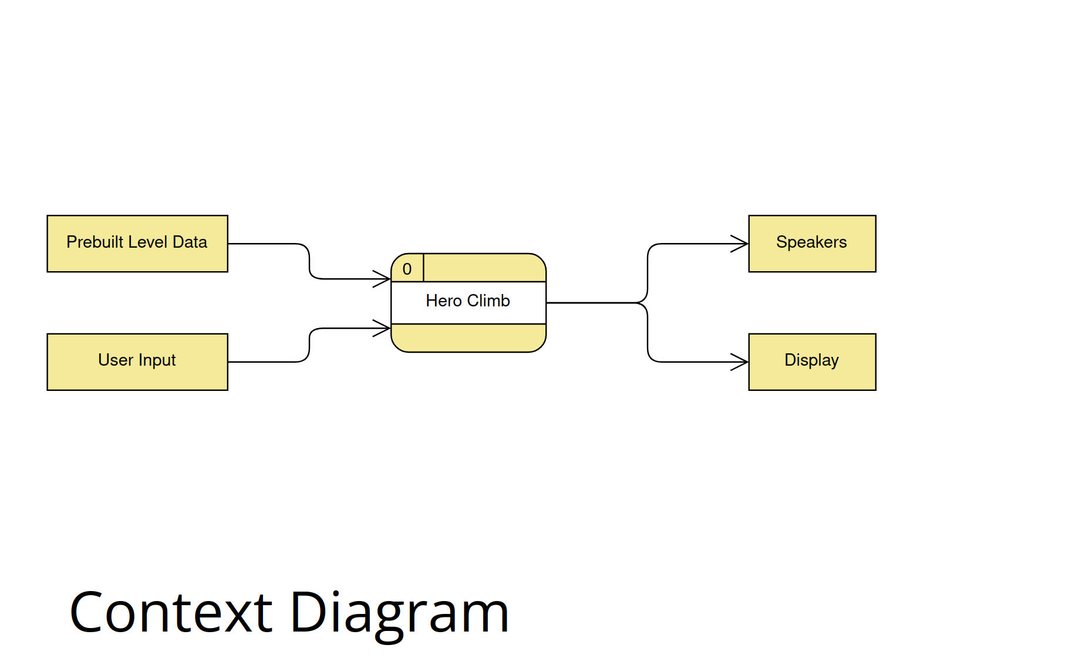

Slide 18
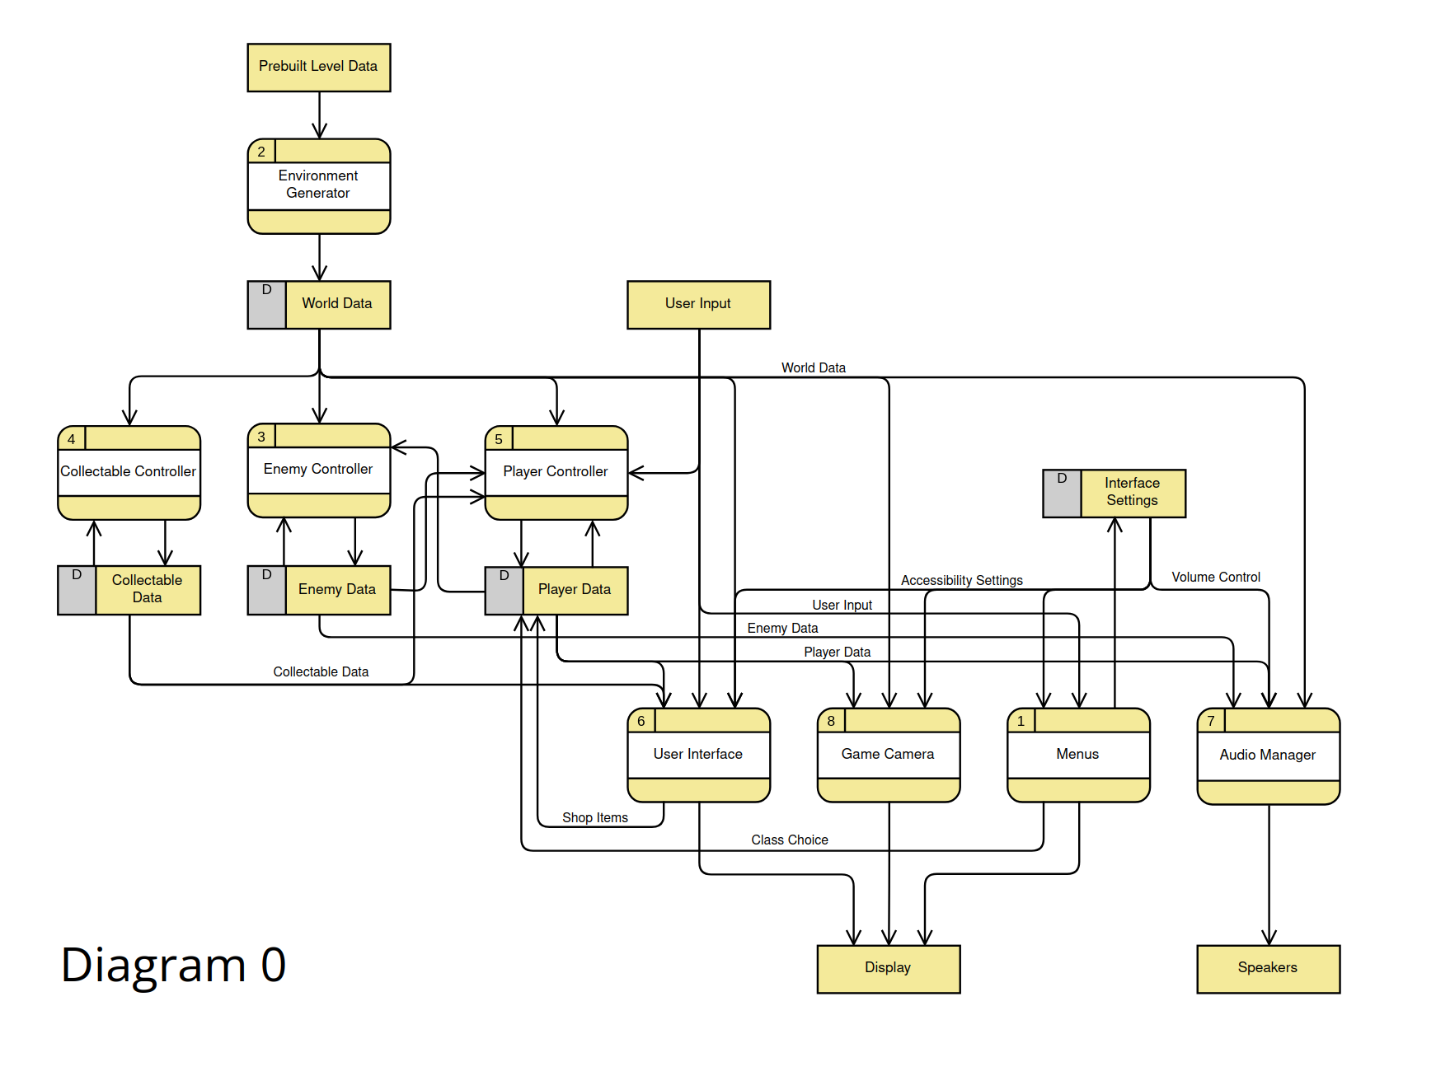
Diagram 0

Slide 19
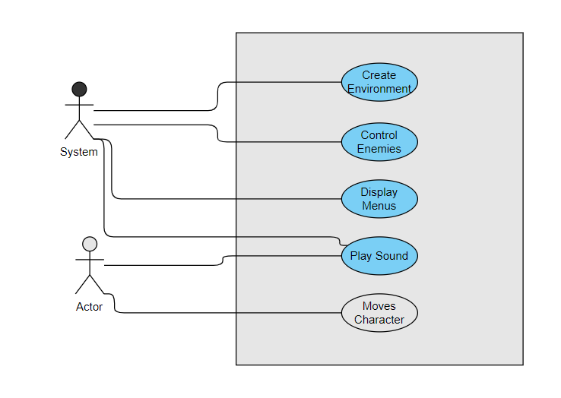
Global Use Case

Slide 20
User Interface
Julia Abdel-Monem

Slide 21
User Interface: Introduction
Allows the player to start the game and select a class, restart the game, change various settings.
Displays an End Screen when the game is over
Displays shops when requested from the world
Displays character health and warnings from the game as requested
Priority: 8/10, varies between features
Julia Abdel-Monem

Slide 22
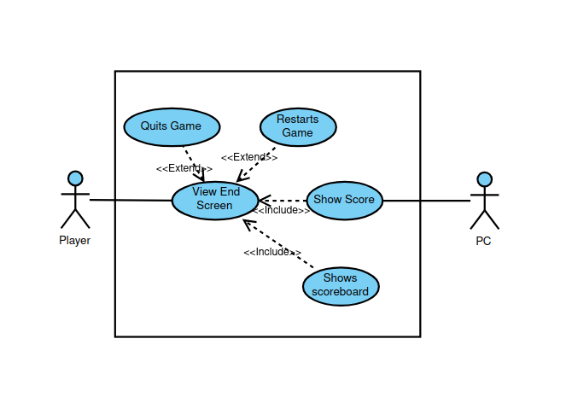
User Interface: End Screen
[Add use case diagram]
[Estimate complexity]
[Answer Questions]
Julia Abdel-Monem

Slide 23
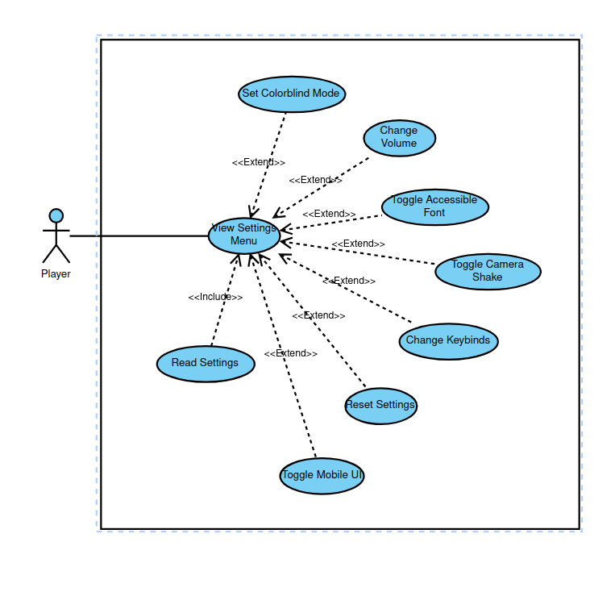
User Interface: Settings Menu
[Add use case diagram]
[Estimate complexity]
[Answer Questions]
Julia Abdel-Monem

Slide 24
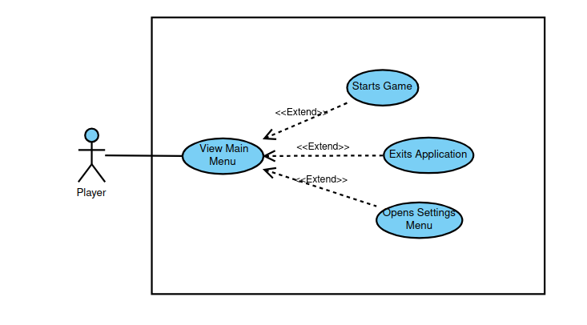
User Interface: Main Menu
[Add use case diagram]
[Estimate complexity]
[Answer Questions]
Julia Abdel-Monem

Slide 25
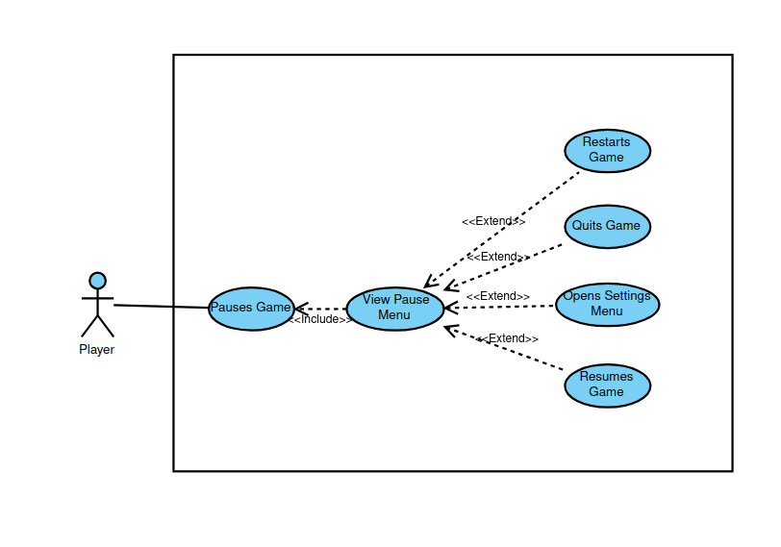
User Interface: Pause Menu
[Add use case diagram]
[Estimate complexity]
[Answer Questions]
Julia Abdel-Monem

Slide 26
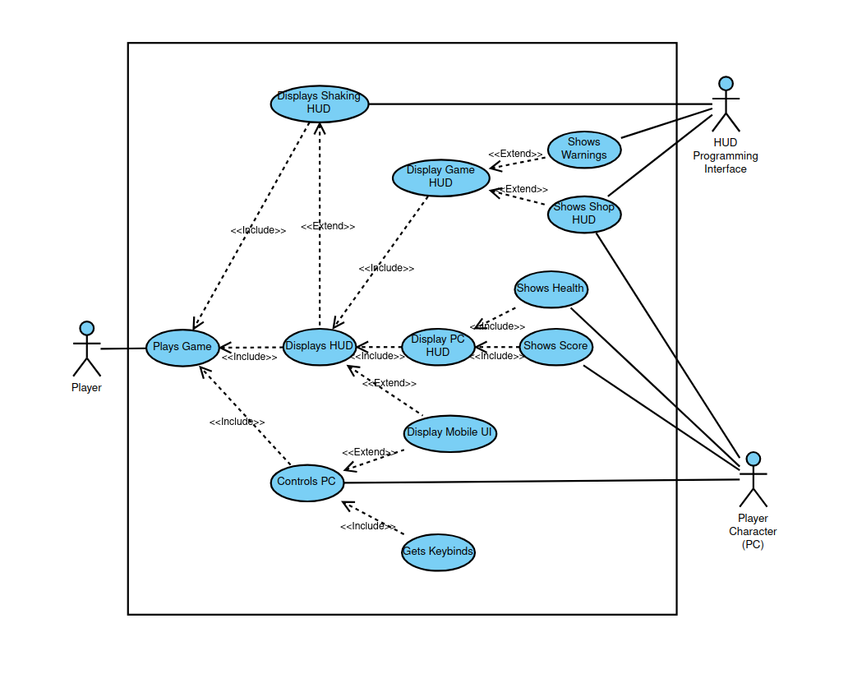
User Interface: Game HUD
[Add use case diagram]
[Estimate complexity]
[Answer Questions]
Julia Abdel-Monem

Slide 27
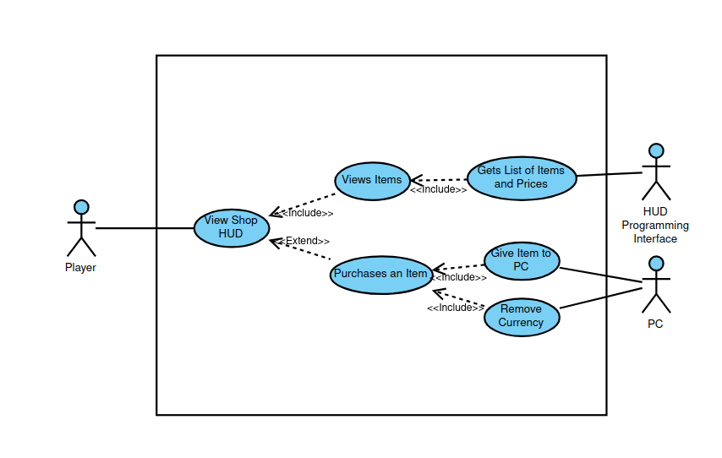
User Interface: Shop HUD
[Add use case diagram]
[Estimate complexity]
[Answer Questions]
Julia Abdel-Monem

Slide 28
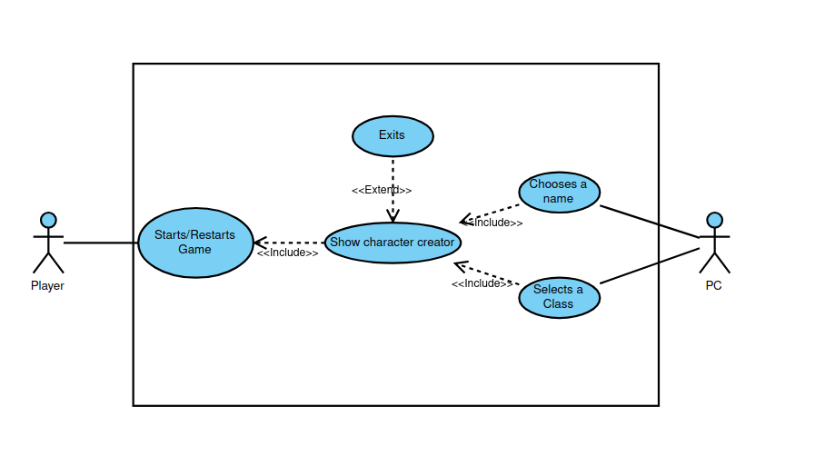
User Interface: Character Creator
[Estimate complexity]
[Answer Questions]
Julia Abdel-Monem

Slide 29
Player Controller
Ferris Hammes-Buehler

Slide 30
Player Controller: Introduction
Overall Role
Priority: 2/5 (Second)
Ferris Hammes-Buehler
Notes:
The player controller provides an essential service; it allows the user to exert influence upon the game world.
Because the player controller is required to test many elements of the game world, I would put its priority at a 2/5.

Slide 31
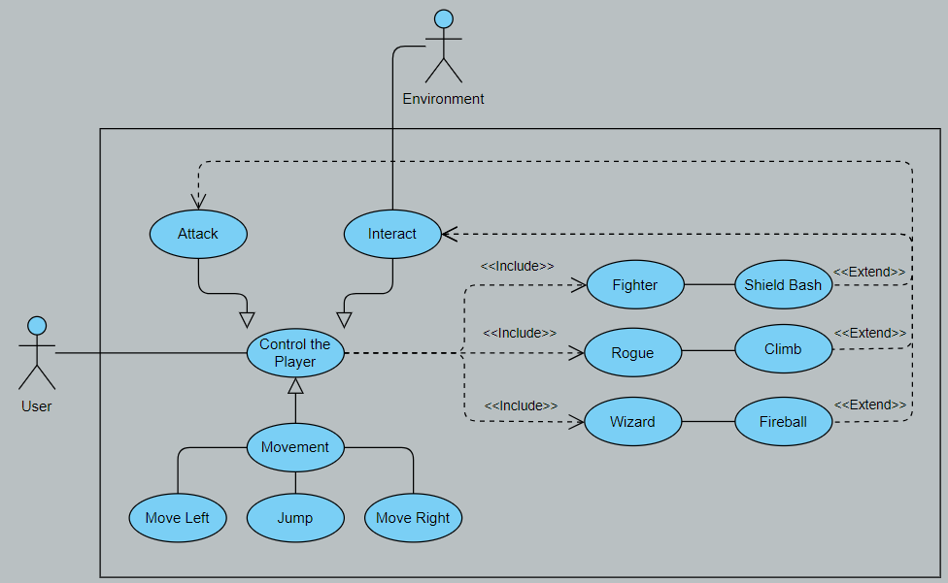
Player Controller: Use Case
Ferris Hammes-Buehler
Notes:
The use case for the player character is relatively simple. It takes input from the user and determines how to move the character sprite and collider.
The different hero classes will be instantiated by taking methods from a default player controller, then extending the attack and interact actions to make the different hero classes feel different. The interact action takes input from the environment to see if the player is touching a pipe or a shop, then sends the relevant signal to either allow the character sprite and collider to move along the pipe or open the shop HUD, whichever is relevant.
On a scale of 1-10, 10 being the most complex, I'd give the player controller a 5/10. The most difficult part will be detecting and correctly linking the parts of the environment that we need to be aware of.
That being said, are there any questions?

Slide 32
Player Controller: Class Diagram
Player Controller
Fighter / Rogue / Wizard
- move_and_slide()
+ ClassType : readonly enum
# movementInput() -> Vector2 : partial
# actionInput() : partial
- movementInput() -> Vector2
// (if ClassType == ClassType.Fighter)
// Code for the Fighter's Shield Bash
// (if ClassType == ClassType.Rogue)
// Code for the Rogue's Climb
- actionInput()
// (if ClassType == ClassType.Wizard)
// Code for the Wizard's Fireball
Ferris Hammes-Buehler
Notes:
Templating out a class for the player controller, the default player controller would have a private method built into Godot called "move_and_slide". This causes the player character to be moved by vectors rather than by direct positioning, and is essential for an easy player controller. It also has a public readonly enum called ClassType that can be called to determine what hero class the player is using. movementInput and actionInput both are partial methods, meaning that they can be templated in the default class and finished in the included class. movementInput handles movement (whoah) and actionInput handles the interact and attack buttons.
For each of the Fighter, the Rogue, and the Wizard each finish the movementInput and actionInput method in their own respective manner, movementInput being augmented by the Fighter's shield bash and the Rogue's Pipe Climb, and actionInput gets augmented by the Wizard's Fireball attack.
Are there any questions about the Player Controller?

Slide 33
Level / Environment
Taran Haug

Slide 34
Level/Environment Introduction
Place where player moves/interacts with other features.
Procedurally generated.
Central, as most other features interact through it.
Priority: 1/5 (First)
Taran Haug
Notes:
The environment is the area in which the player and enemies will be able to move around and interact with each other and other features.
The environment will be procedurally generated, to increase the unpredictability and replayability of the game.
The environment is central to the overall design of the game, because it is the space in which nearly every other feature of the game interacts.
Because of this, it is the feature with the highest priority.

Slide 35
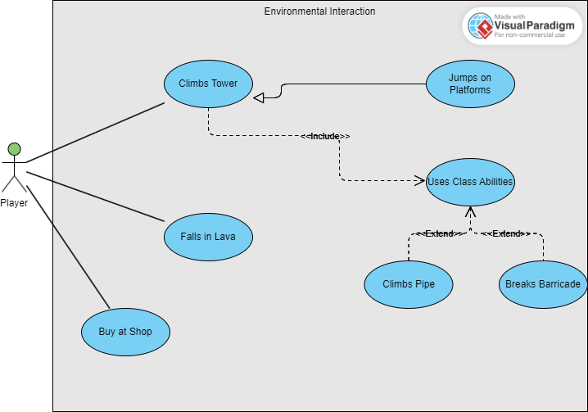
Level/Environment Use Case
Taran Haug
Notes:
Here we have a basic use case for how the player interacts with the environment.
The player can buy things at the shop, or the player can fall in the lava and die, or the player can climb the tower.
Climbing the tower could mean jumping on platforms to get higher, or it could include using class abilities. The class abilities would obviously vary based on the player's class.
In terms of complexity, I would give the environment an 8/10. As simple as the use cases are, there’s a lot of groundwork that has to go into the environment to make sure every things works together properly.

Slide 36
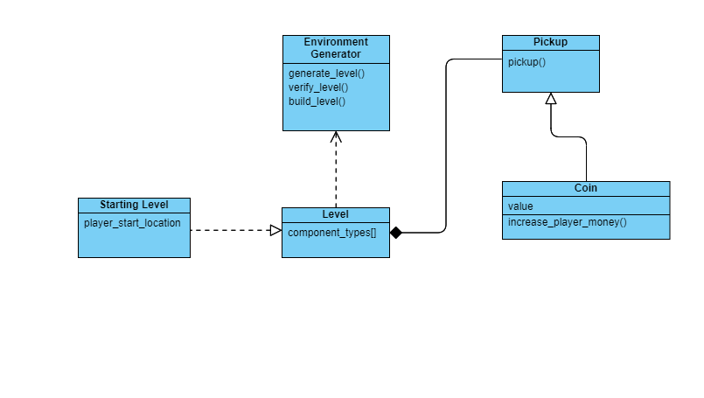
Level/Environment Class Diagram
Taran Haug

Slide 37
Enemy AI
Jason Culbertson

Slide 38
Enemy AI Introduction
Controls the hostile non-playable characters
Controlling Consists of:
Moving
Attacking
Detecting
Taking Damage
Priority 3/5 (Third)
Jason Culbertson

Slide 39
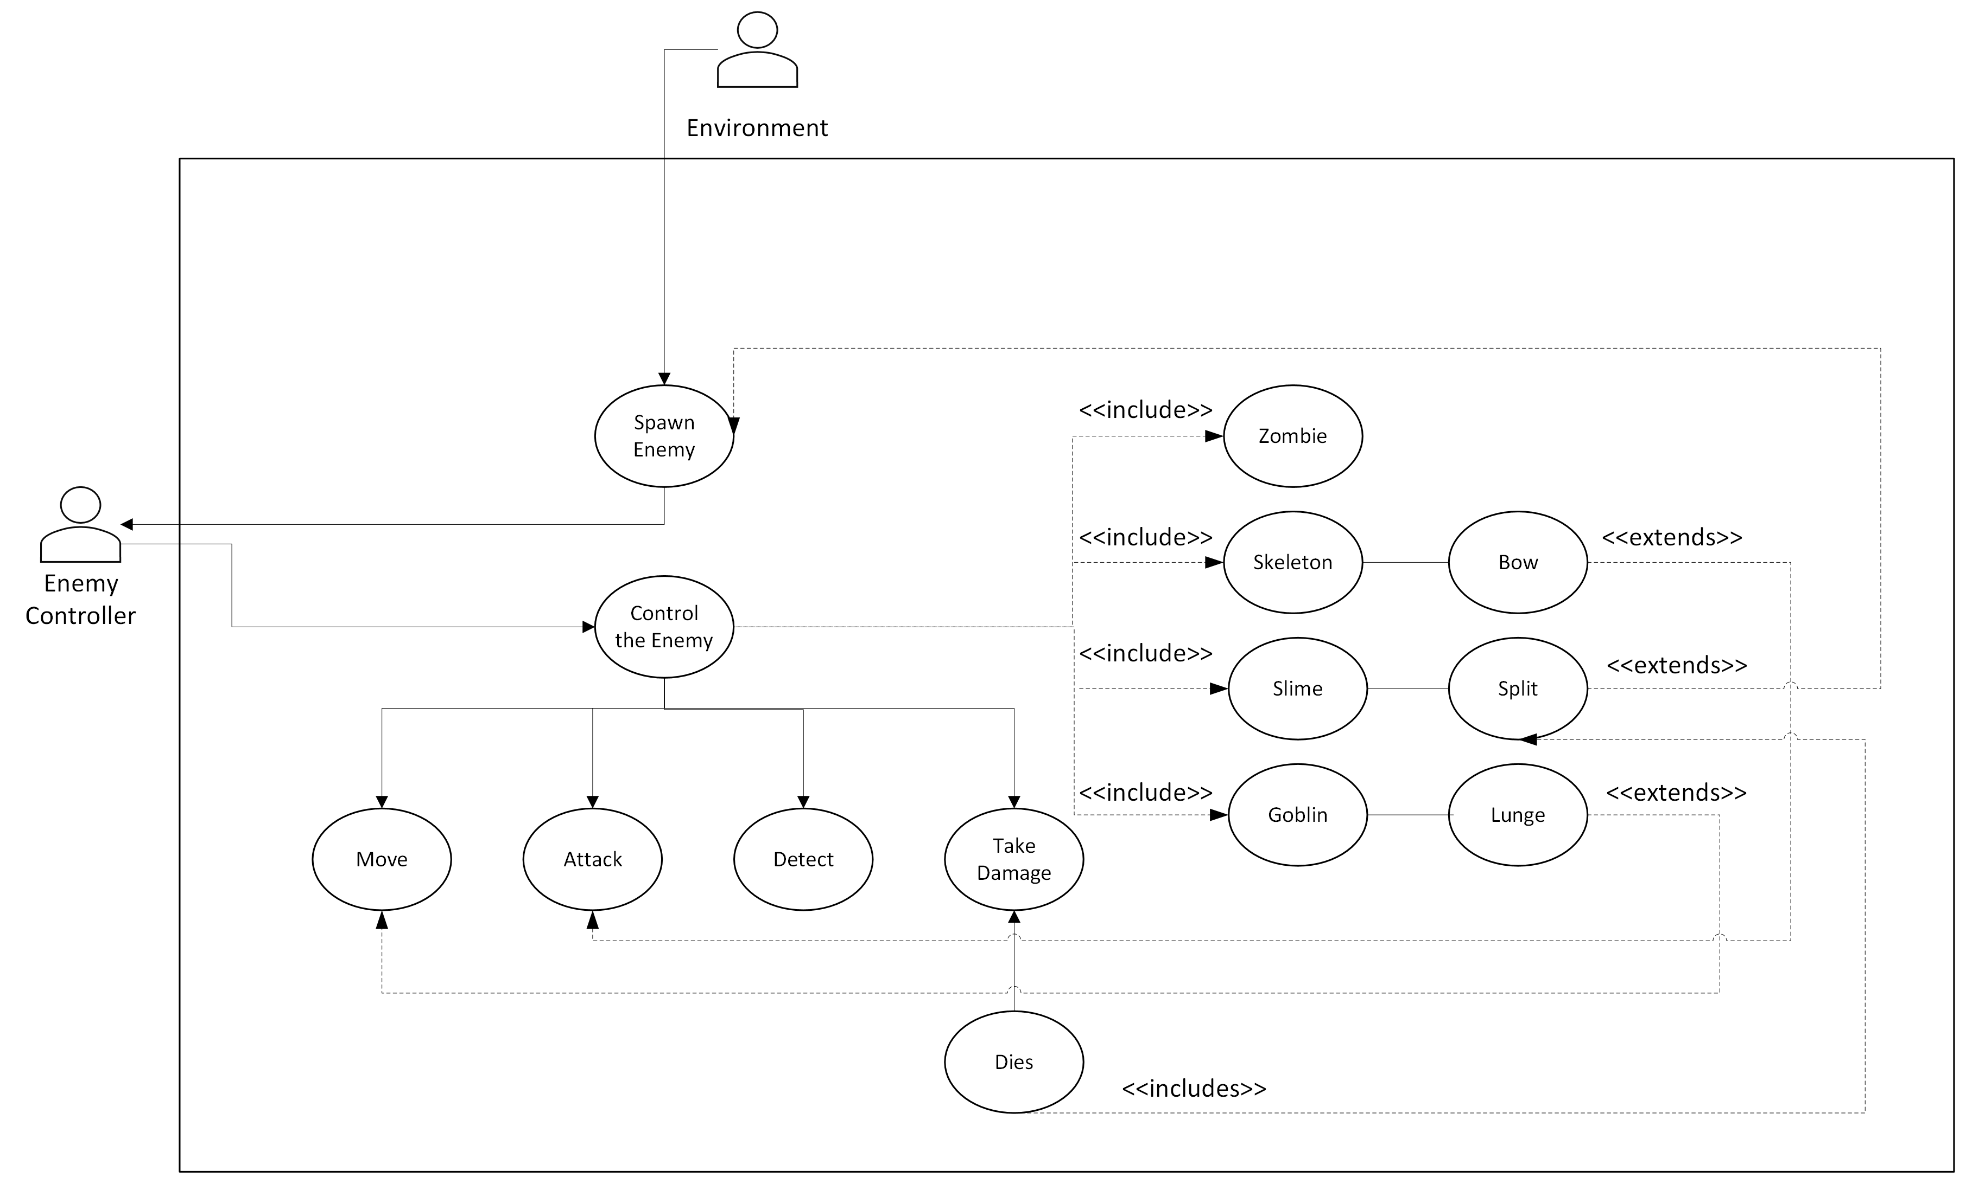
Enemy Controller Use Case
Jason Culbertson

Slide 40
Enemy Controller: Class Diagram
Enemy Controller
Zombie/ Skeleton / Slime / Goblin
- move()
attack()
detect()
take_damage()
// (if ClassType == ClassType.Skeleton)
// Code for the Skeleton's bow
// (if ClassType == ClassType.Slime)
// Code for the Slime's splitting
// (if ClassType == ClassType.Goblin)
// Code for the Goblin's lunge
Jason Culbertson
Notes:
Templating out a class for the player controller, the default player controller would have a private method built into Godot called "move_and_slide". This causes the player character to be moved by vectors rather than by direct positioning, and is essential for an easy player controller. It also has a public readonly enum called ClassType that can be called to determine what hero class the player is using. movementInput and actionInput both are partial methods, meaning that they can be templated in the default class and finished in the included class. movementInput handles movement (whoah) and actionInput handles the interact and attack buttons.
For each of the Fighter, the Rogue, and the Wizard each finish the movementInput and actionInput method in their own respective manner, movementInput being augmented by the Fighter's shield bash and the Rogue's Pipe Climb, and actionInput gets augmented by the Wizard's Fireball attack.

Slide 41
Audio
Gavin Haynes

Slide 42
Audio - Introduction
Games with sound are more immersive
Player animations
Game events: defeating enemies, collecting coins
Warnings

Slide 43
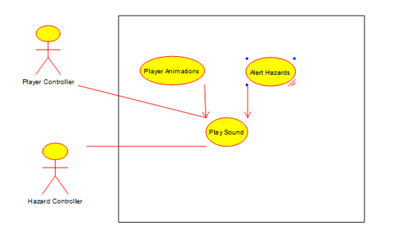
Audio - Use Case Description
Gavin Haynes

Slide 44
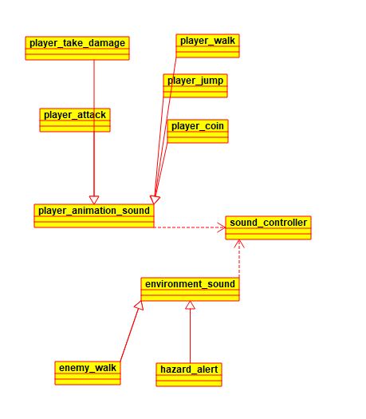
Audio - Class Diagram
Gavin Haynes

Slide 45
Audio - Priority & Complexity
Complexity
Medium, as hazard alerts should speed up as lava approaches
Otherwise straightforwards
Low priority
Other visual indicators in hud take more priority
Add to immersion but are not necessary
Gavin Haynes

Slide 46
Any Questions?
Thank you!

